Slide 1
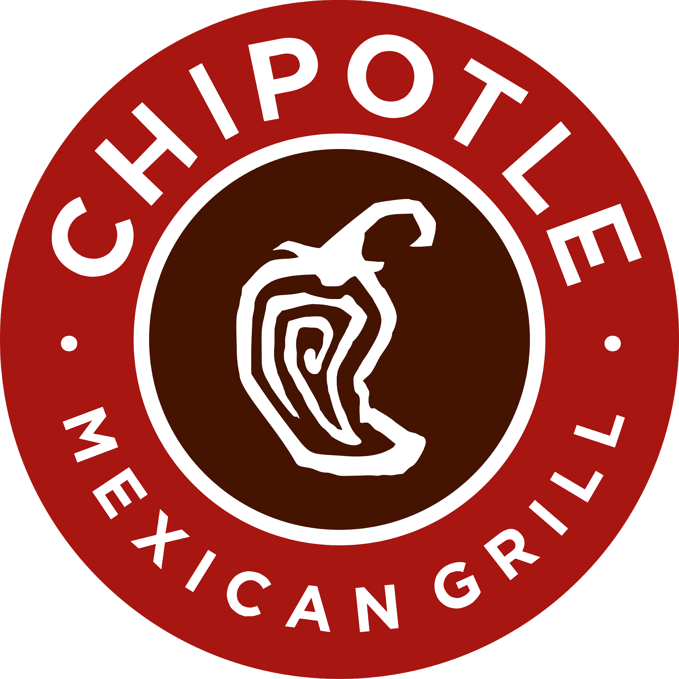
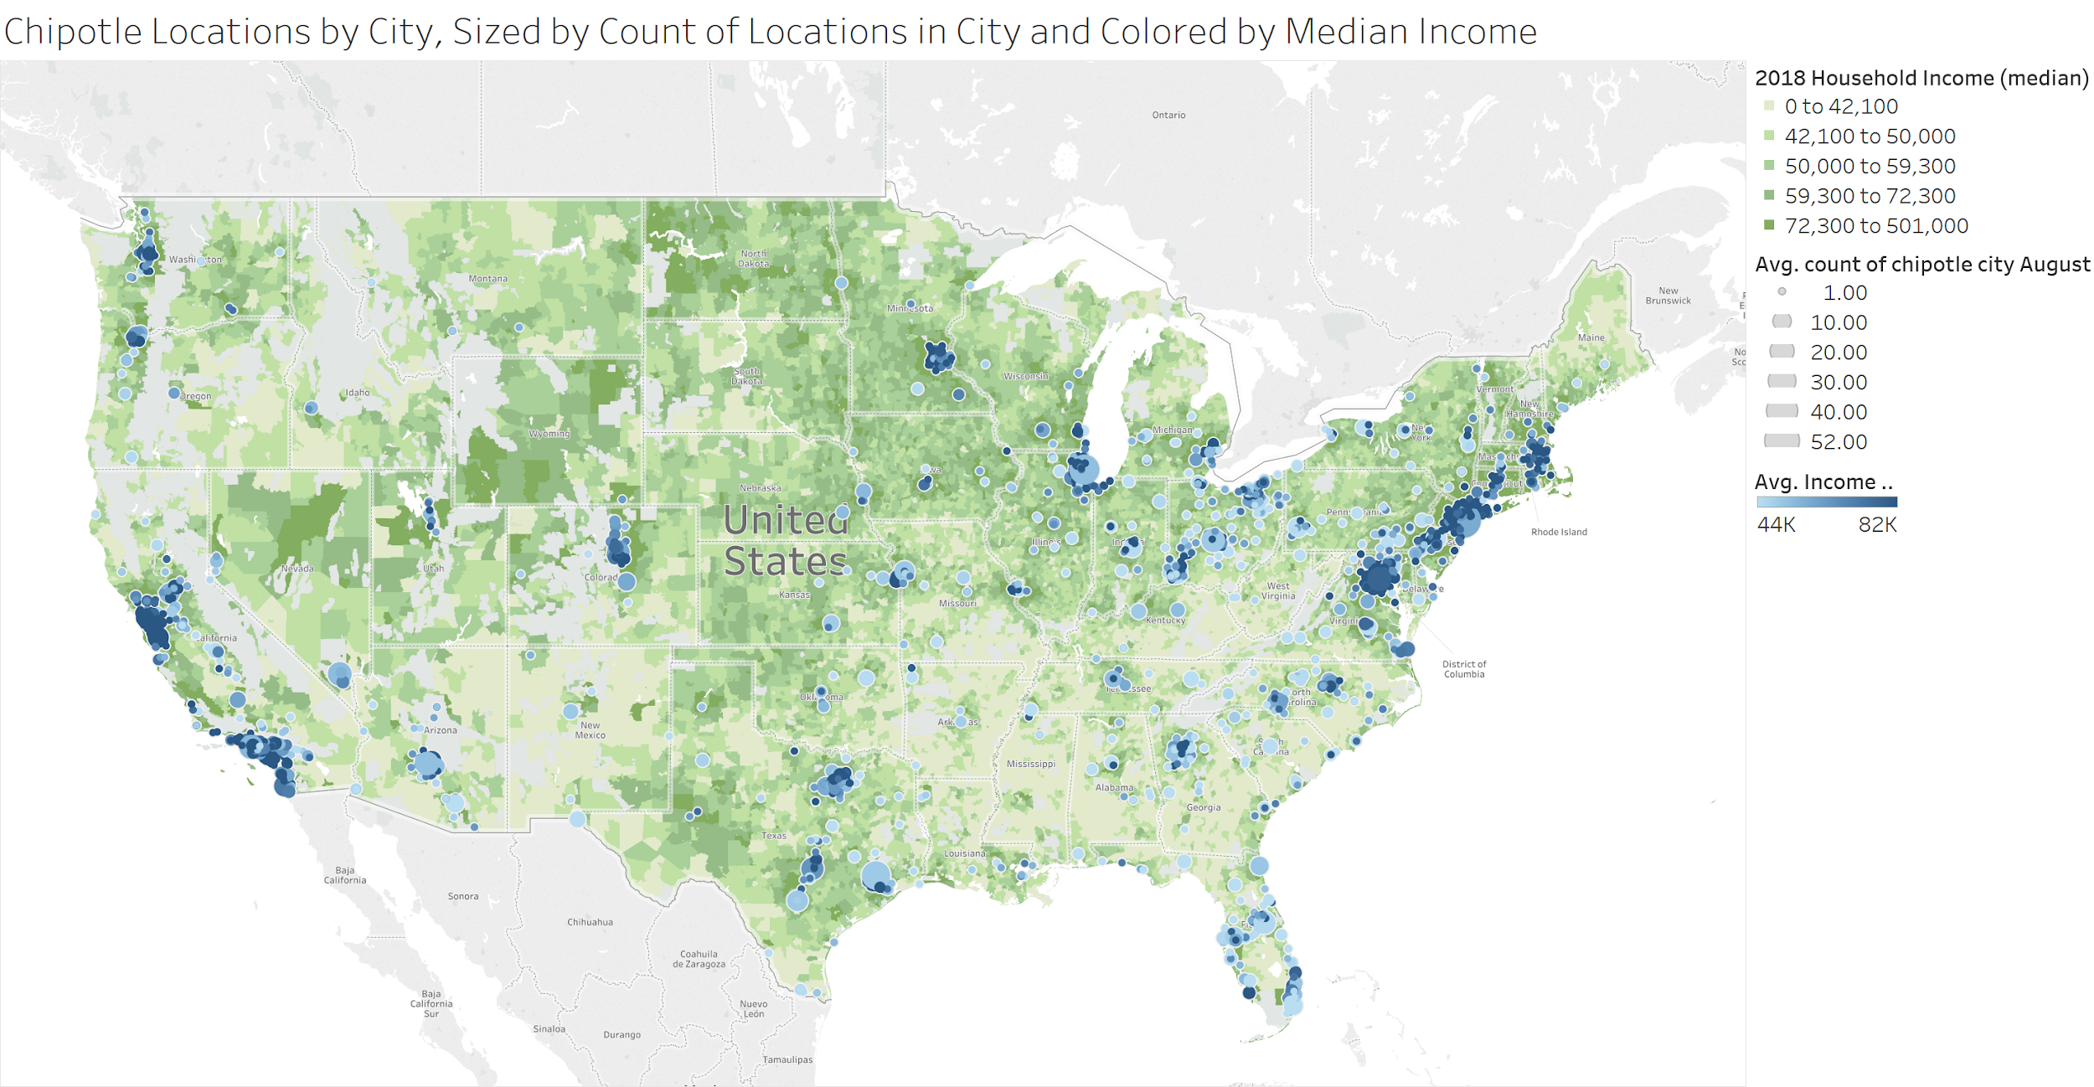
Exploring Chipotle Locations in the USA
Dan Goetz and Joey Sabel
Notes:
Dan

Slide 2
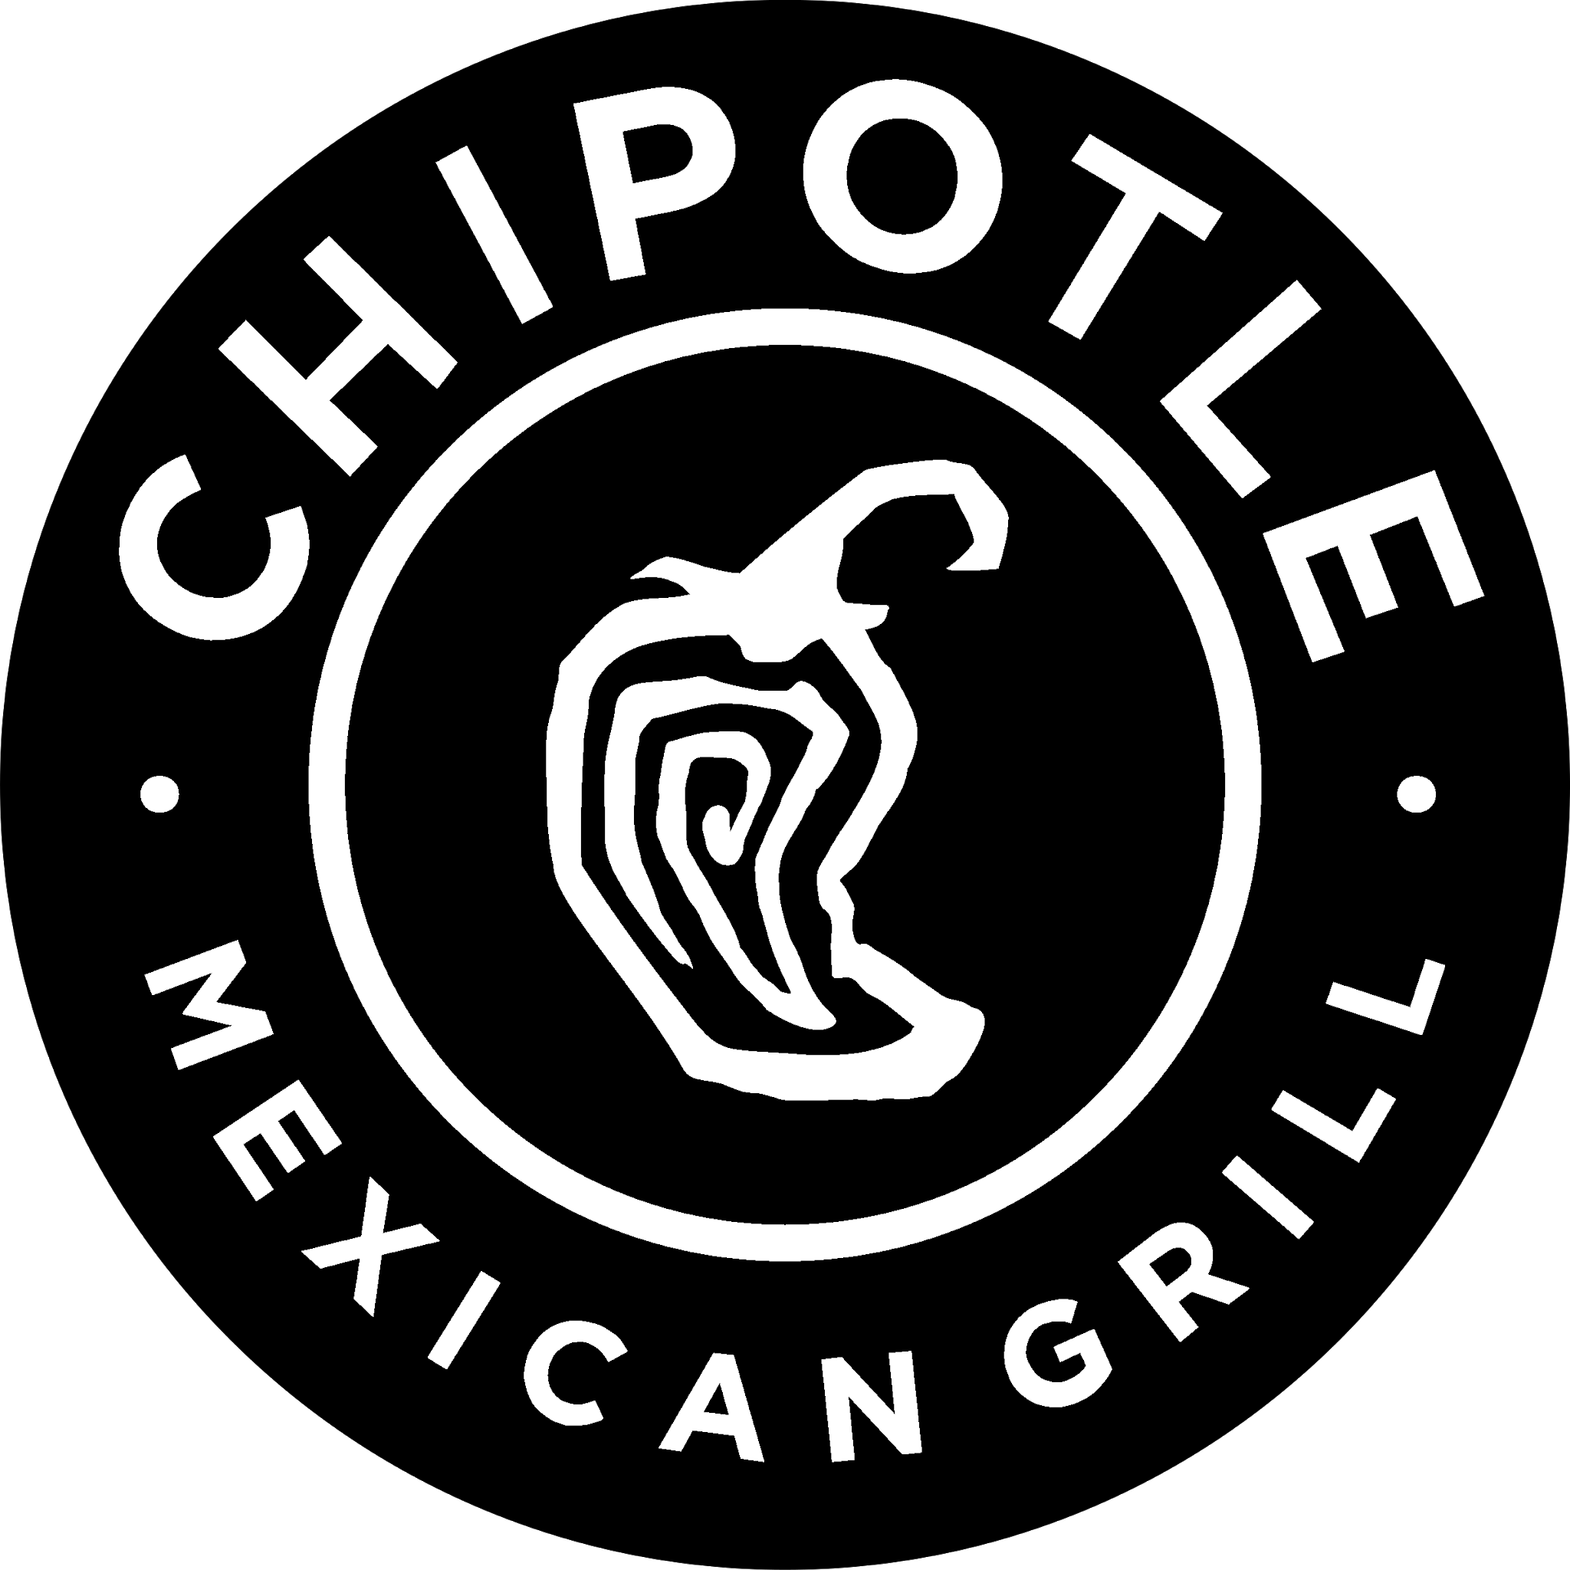
Overview
Introduction
Variable Selection
Data Preprocessing
Modeling Techniques
Linear/Logistic Regression
K-Nearest Neighbor
K-Means Clustering
Decision Tree Classifier
Results
Conclusion
Notes:
Dan

Slide 3
Variable Selection
Demographics
Age
Income
Population
Family Size
Education Levels
Racial Diversity (referred to as Race ___)
Notes:
Joey

Slide 4
Data Preprocessing
GENERAL
Remove NA values and filter by population (min 601, size of smallest city with a Chipotle)
12,000 cities were removed in this step
Adjusted population and income maximums to be at 99th and 90th percentiles
FOR K-MEANS ONWARD
Winsorized all variables (except population and income) to be between 5th and 99th percentiles
Notes:
Joey

Slide 5

Modeling Techniques
Notes:
Joey

Slide 6
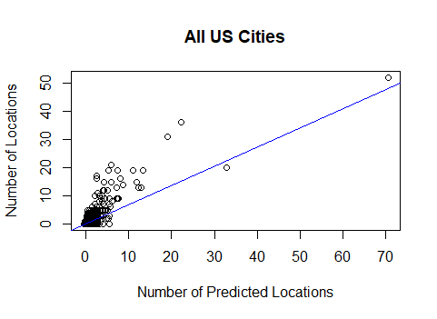
Linear Regression
Statistically Significant Variables
Median Age
Median Income
Population
Family Size
Education Level
Race White
Race Asian
Negative Coefficient Variables
Median Age
Median Income
Family Size
Race Asian
R^2 is .6798
Notes:
Joey

Slide 7
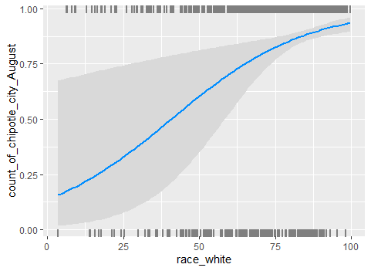
Logit Regression
Significant Variables (All were negative)
Race White
Age
Median Income
Family Size
Education
We decided not to include population because big cities skewed the data.
There were only 183 incorrect predictions (15 false positives and 168 false negatives), resulting in a 92.12% accuracy.
Notes:
Dan

Slide 8
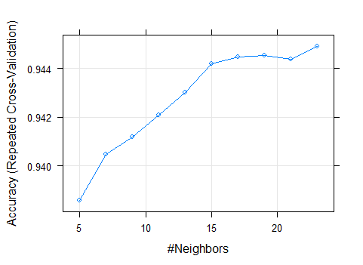
K-Nearest Neighbors
In total, three K-Nearest Neighbor (KNN) models were run with different specifications for trainControl method and tuneLength.
Our base model (23 neighbors) was run based on a training set of 80% of the data, repeatedcv, and tuneLength = 10, which happened to be our best model of the three
Training accuracy of .94492, which is very high as well as a test confusion matrix accuracy of .9447
Notes:
Dan

Slide 9
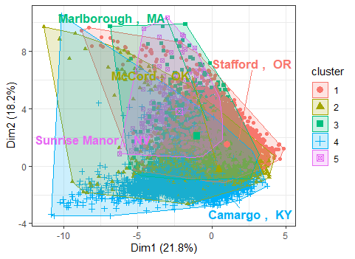
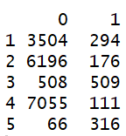
K-Means Clustering
Using Weighted Sum of Squares (WSS) method, an elbow plot showed 5 clusters
Center cities by euclidean distance are Stafford, OR; McCord, OK; Marlborough, MA; Camargo, KY; and Sunrise Manor, NV
There was no difference when winsorizing the variables mentioned on slide 4
Cluster 5 has the most
Chipotle locations
Median Income
Median age
Notes:
Joey

Slide 10
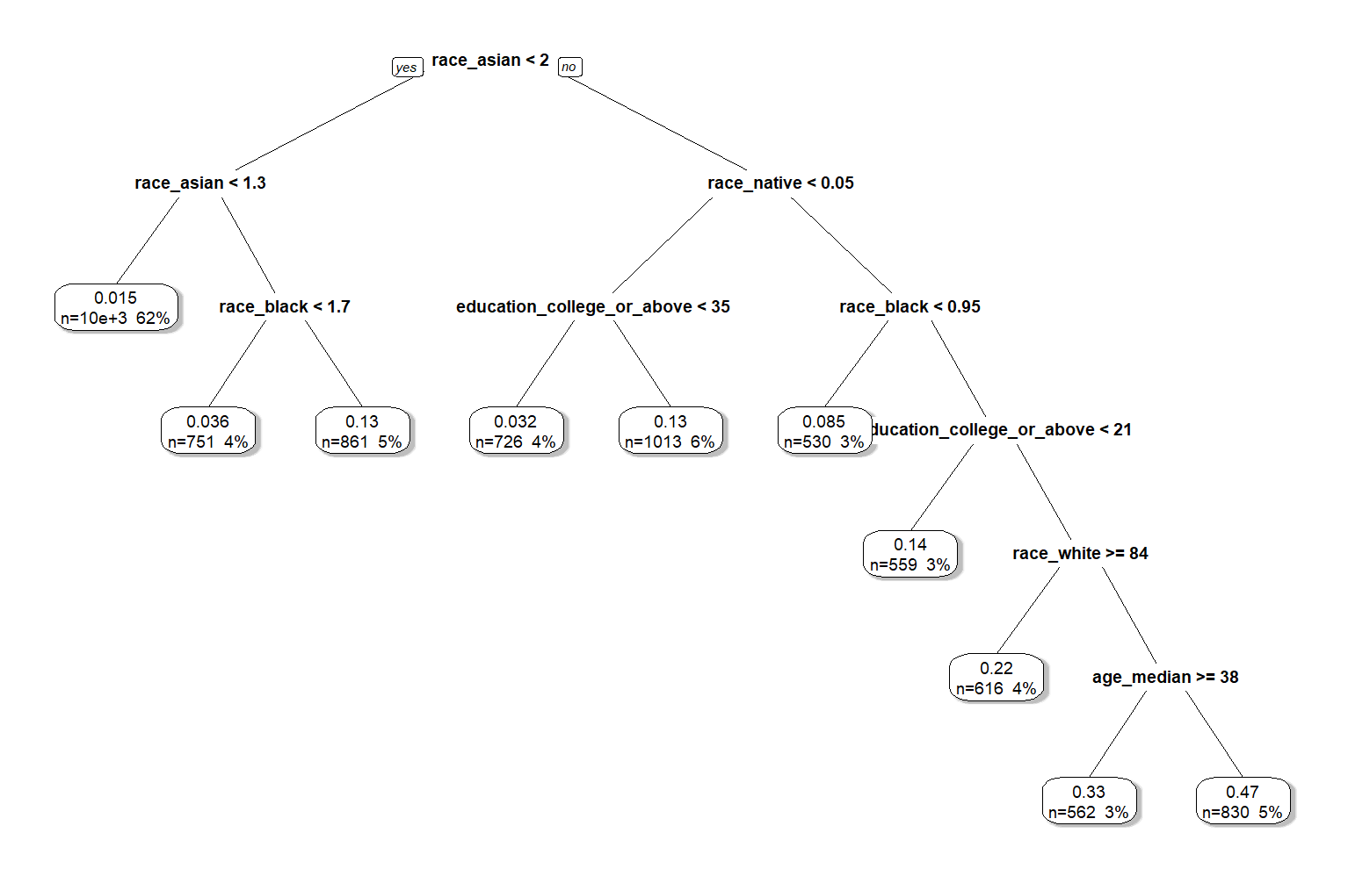
Decision Tree Classifier
The tree shown had specifications of a complexity parameter of 0.003, a min bucket of 350, along with a minimum split of 25.
Race is an important factor as shown to the right. Along with age and education
81% of cities are accounted for in the first two splits of branches
Notes:
Dan

Slide 11
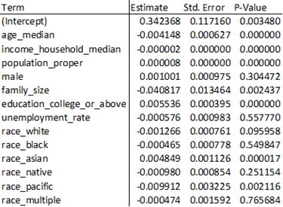
Results
Linear Regression
Almost all of the races are negative in relation to the dropped race, Race Other. We assume this is mostly Latinx people since they are not specified anywhere else
Logistic Regression
In final model without population_proper, there were 883 correct predictions (above 50% probability). Race, age and education were the most important factors. College town are an ideal candidate.
Notes:
Dan

Slide 12
Results
K-Nearest Neighbors
Training Accuracy was .9449 We looked at the 23 closest points. The test accuracy was very similar at .9447.
The KNN method proved more efficient at predicting whether or not a Chipotle would open in a particular city than the logistic model.
78 false negatives and 32 false positives
False Negatives were mostly college towns with small populations
False Positives were big cities like Detroit.
K-Means Clustering
Cluster breakdown
Cluster 1 has small populations (avg of 8000)
Cluster 2 has a small, very white population with low educated people
Cluster 3 has larger cities with above-average income
Cluster 4 has small populations with low income; highest majority populations
Cluster 5 is big cities
Decision Tree
As we go further along the tree, we see we want high educated, low age people for demographics
Notes:
Dan

Slide 13
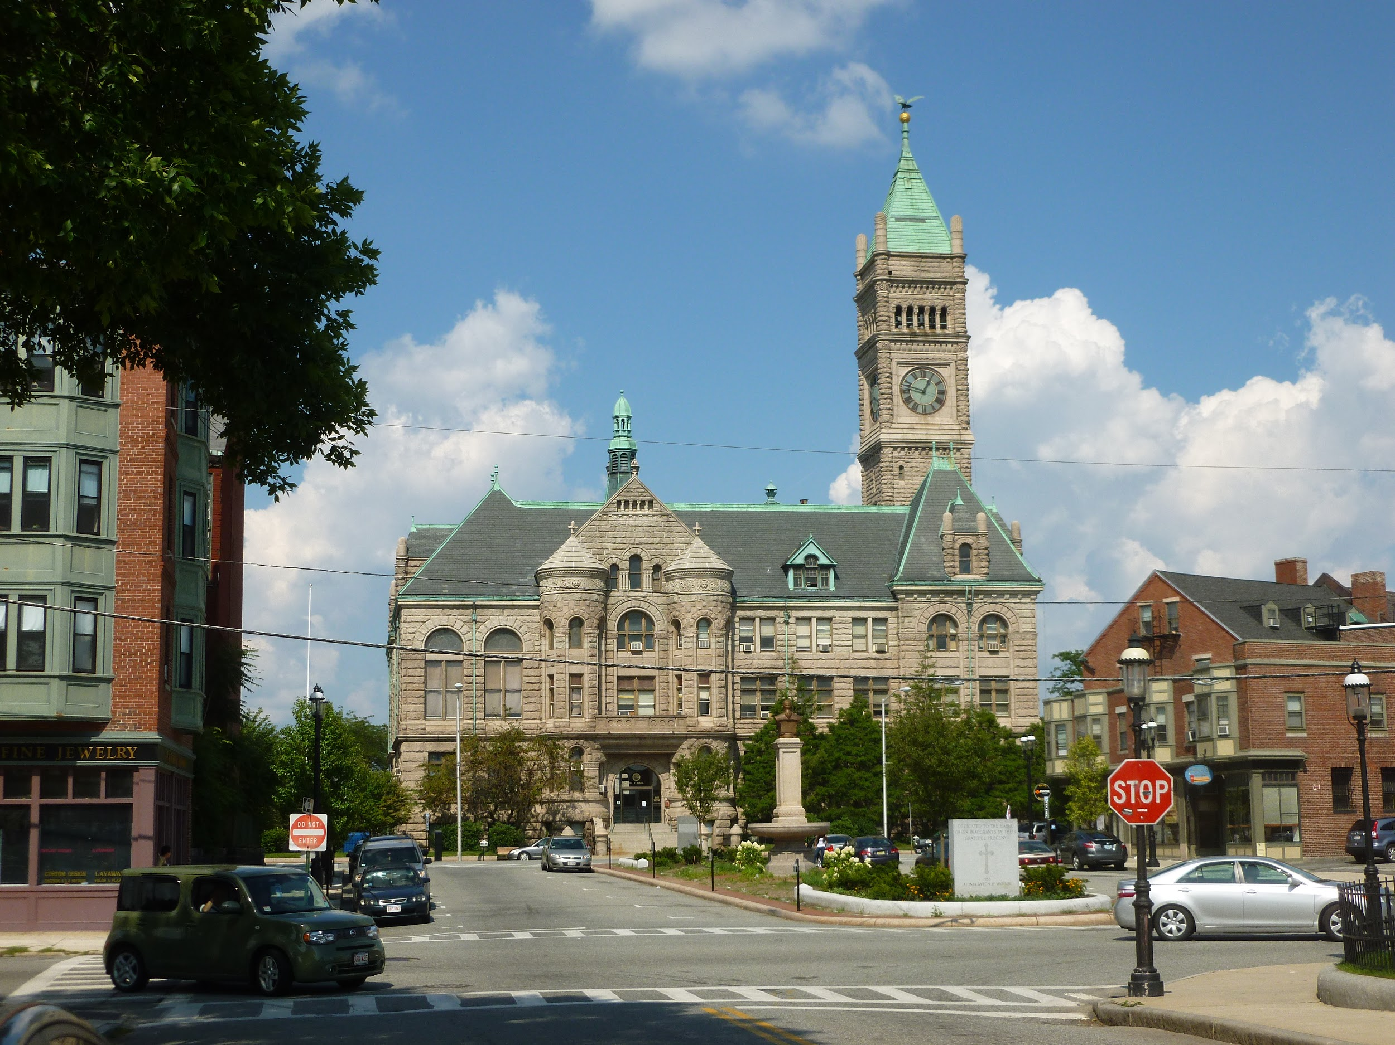
Conclusion
Top City That Should Have a Chipotle That Doesn’t
Lowell, Massachusetts
A breakdown:
Population: 111,346
Education: 22.6%
Lowell is a college town (with UMass - Lowell), so we expect them to have a lot of interest)
Logit Regression Results: .96 Probability
Cluster Results: Cluster 5
Notes:
Joey

Slide 14
Thank You!
Notes:
Joey

